Slide 1
XLC Loader
Performance Analysis

Slide 2
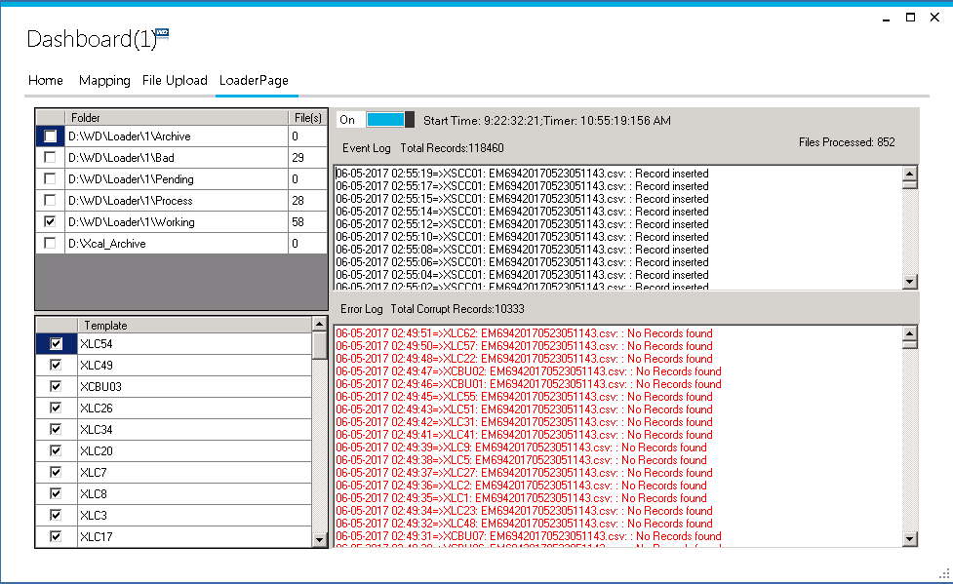
Stats
Total Records processed | 140K
Files Processed | 850
Time Taken | 65 Hours

